Slide 1
Tests
3APIS

Slide 2
3APIS – Tests
Course Objectives
By the end of the course, students should:
Learn about testing
Understand what tests can bring to a project
Know how to test a Node.js project
Be aware of testing strategies for API

Slide 3
Summary
Purposes
Node.js testing
API testing

Slide 4
1. Purposes

Slide 5
1. Purposes
In the realm of software engineering, testing is a systematic and essential process aimed at evaluating the functionality, reliability, and performance of a software application.
It involves running the software under various conditions to identify bugs, defects, or deviations from expected behavior.
The primary purpose of testing is to ensure that the software meets specified requirements and adheres to quality standards, ultimately boosting confidence in its correctness and reliability.

Slide 6
1. Purposes
Testing serves multiple crucial purposes within the software development lifecycle.
Firstly, it is instrumental in bug detection, allowing developers to identify and rectify defects early in the development process.
Secondly, testing verifies that the software aligns with specified requirements, providing assurance that it behaves as intended.

Slide 7
1. Purposes
Beyond bug detection and requirement verification, testing is integral to enhancing overall software quality, preventing regressions, and validating the application's performance under different conditions.

Slide 8
1. Purposes
In the context of Node.js applications, various types of tests are employed to ensure the application's robustness and adherence to requirements.
Unit testing focuses on verifying individual components, such as functions or methods, to ensure their correctness.
Integration testing assesses the interaction between different components, while end-to-end (E2E) testing validates the entire application workflow.

Slide 9
1. Purposes
Functional testing evaluates the functionality of the application based on specifications, and performance testing assesses its responsiveness and speed.
Security testing aims to identify vulnerabilities, while snapshot testing captures and compares application outputs to detect unintended changes.
These diverse testing types collectively contribute to comprehensive software quality assurance.

Slide 10
1. Purposes
Adhering to best practices is crucial for effective testing in Node.js applications.
Automation of tests ensures repeatability and efficiency, enabling developers to run tests consistently.
Integration of testing into continuous integration (CI) pipelines helps detect issues early in the development process.
Isolation of tests ensures independence and prevents interference between different test cases.

Slide 11
1. Purposes
Techniques like mocking and stubbing are employed to isolate components and focus on specific functionalities during testing.
Monitoring and improving code coverage ensure that tests adequately cover the application's codebase.
Designing tests to reflect real-world scenarios ensures that the application behaves as expected in production.

Slide 12
1. Purposes
Testing stands as a cornerstone in the pursuit of reliable and high-quality software.
By adopting a comprehensive testing strategy, developers can confidently deliver Node.js applications that meet user expectations and adhere to the highest standards of performance and correctness.

Slide 13
1. Purposes
As a global estimation it is often considered that writing good tests take a long time
At least a 30% increase of the time of the feature
But you spend less time after to fix bugs
It is a "pay now enjoy later" kind of deal

Slide 14
1. Purposes
In an imaginary case you have to build a function which will allow you to add two numbers together.
What tests do you want to implement ?
What are the cases that you think need to be tested ?
Try to think about everything.

Slide 15
1. Purposes
Most of you got the basics cases
add two positive numbers
add two negative numbers
add one positive and one negative
add a word and a number
add a number and a word

Slide 16
1. Purposes
But did you think about some edge cases?
what if the two numbers are very large?
what if a string is containing a number?
what if a value is null or undefined?

Slide 17
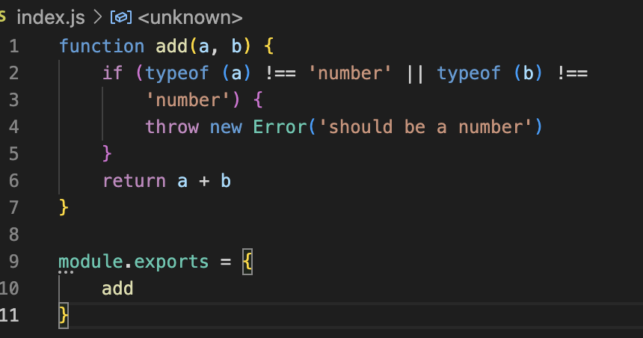
1. Purposes
In a perfect world we want to verify all that. Let's take a basic add function that we will use for all the examples

Slide 18
1. Purposes
First of all we need a runner. A solution to run our test and provide an easy way to see the result.
For that we will use mocha but a lot of others solutions are existing.
This time we use “--save-dev” as the test runner is only needed in development and should not be packaged in production ! You can also save it globally with -g

Slide 19

Exercises

Slide 20
2. Node.js testing

Slide 21
2. Node.js testing
In a test file for a Node.js application, developers use various keywords and structures to define and organize their tests.
Here are the key components commonly found in a test file, along with explanations of the primary keywords:
describe
it
before / after
skip / only

Slide 22
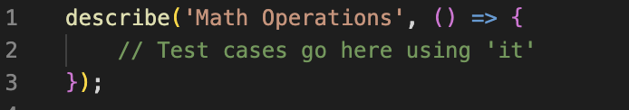
2. Node.js testing
describe
The describe function is used to group related tests into a test suite.
It takes a string description and a callback function that contains the individual test cases (using it statements).
This structure helps in organizing tests hierarchically.

Slide 23
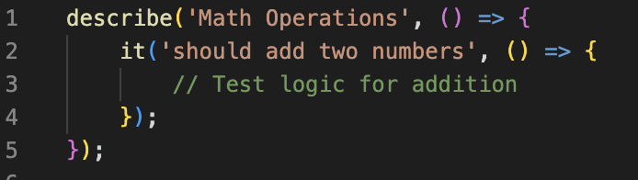
2. Node.js testing
it
The “it” function is used to define individual test cases within a describe block. It also takes a description (string) and a callback function containing the actual test logic.
Each it statement represents a specific test scenario.

Slide 24
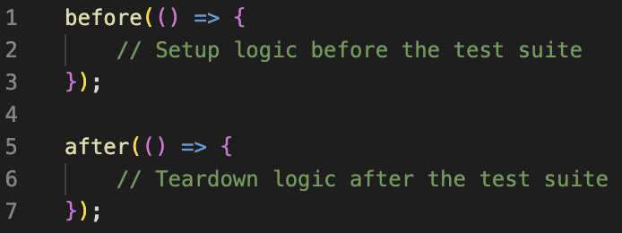
2. Node.js testing
before / after
The before and after functions allow developers to define setup and teardown logic that runs once before and after the entire test suite, respectively. beforeEach / afterEach can also be used, they run before/after each tests !

Slide 25
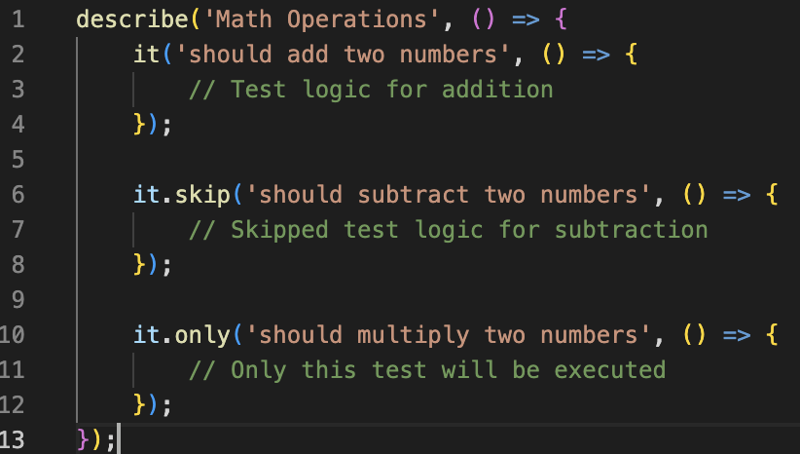
2. Node.js testing
skip / only
The skip function allows you to skip a particular test or test suite, while the only function runs only the specified test or test suite. These functions are useful for selectively executing tests during development or debugging.

Slide 26
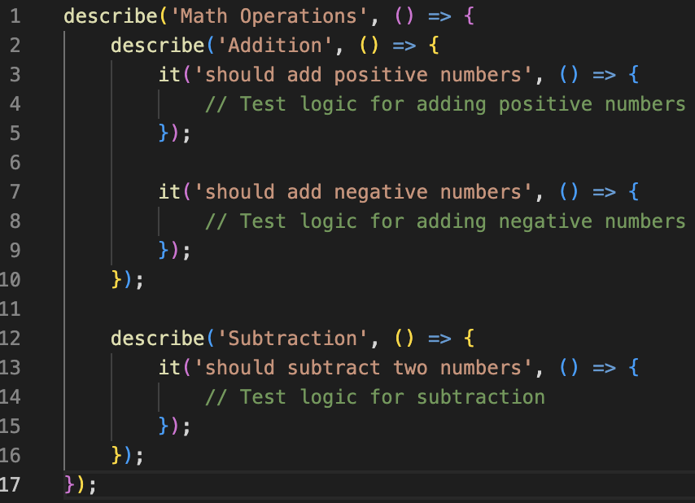
2. Node.js testing
describe: nested
You can nest describe blocks within other describe blocks to create a hierarchical structure for organizing tests. This is useful for categorizing tests based on functionality or components.

Slide 27
2. Node.js testing
Unit testing is a software testing technique where individual components or units of a program are tested in isolation to ensure that each unit functions as intended.
The goal is to validate the correctness of specific functions, methods, or modules, isolating them from the rest of the application.
In Node.js, unit testing plays a crucial role in maintaining code quality, facilitating early bug detection, and supporting code refactoring.

Slide 28
2. Node.js testing
Key characteristics of Unit Testing
Isolation: Unit tests focus on isolating a specific unit of code, such as a function or method, from the rest of the application. This allows for targeted testing of individual components.
Fast Execution: Unit tests are designed to execute quickly, providing rapid feedback to developers. This enables frequent testing during development without causing significant delays.
Automated Execution: Unit tests are typically automated and integrated into the development workflow, often executed through test runners like Mocha, Jest, or Ava. Automation ensures consistent and repeatable testing.

Slide 29
2. Node.js testing
Key characteristics of Unit Testing
Mocking: To isolate units during testing, developers may use mocking techniques to replace external dependencies with controlled substitutes. This ensures that the focus is solely on the unit being tested.
Testable Units: Code should be designed with testability in mind. Well-structured and modular code allows for easier creation and maintenance of unit tests.

Slide 30
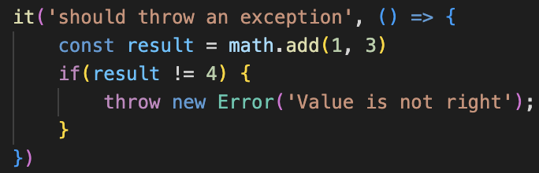
2. Node.js testing
We have seen all the keyword to create some good tests, but we still lack how we are going to test some code.
The manual way would be to call a function, get the result and throw an error if there is an error or do nothing if this is the good result

Slide 31
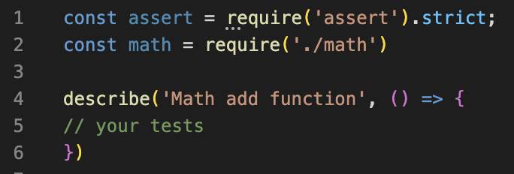
2. Node.js testing
This can work, but on large project (and even small project to be honest) this would be tedious to maintain all that manually. And it would be quite complexe to do some advanced test operation like mock a function or spy a call. For that we can use the “assert” library, part of Node Core

Slide 32
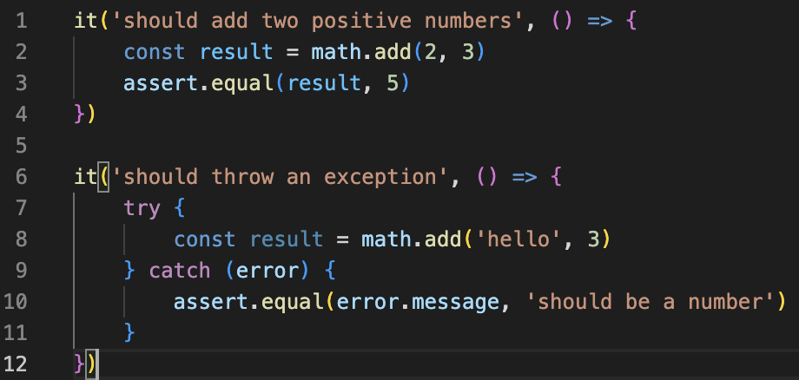
2. Node.js testing

Slide 33
2. Node.js testing
This is an example of some basic tests using only the solution already present inside Node.js
import the file we want to test
use the describe and it keyword
import the assert keyword

Slide 34
2. Node.js testing
To run it simply write and execute in your terminal. If mocha is not installed globally use the mocha library installed in your project.

Slide 35
2. Node.js testing
If you are using Node.js v20 (and above) you can now use the runner part of the core. You don’t need to install a library like mocha. You will find all informations in the documentation. This can be used if you need a quick test runner, but can also replace your standard test runner as most of the capabilities have been added to the one in core
describe / it
after / before
skip / only
mock
reporter

Slide 36
2. Node.js testing
Some runners that you can want to try out
Jest
Developed by Facebook, Jest is a powerful and opinionated test framework. It comes with an integrated assertion library, mocking capabilities, and features like snapshot testing and code coverage reports.
Mocha
Mocha is a versatile and widely used test framework. It provides a flexible and feature-rich testing environment, supporting various assertion libraries and asynchronous testing.
AVA
Ava is known for its fast test execution, running tests concurrently to reduce suite execution time. It emphasizes simplicity, minimal configuration, and isolated test environments.

Slide 37
2. Node.js testing
And with that multiple libraries that can be used to assert of use another way to test a value (expect being also used quite often)
Chai
Chai is a versatile assertion library that supports multiple assertion styles (should, expect, and assert). It integrates seamlessly with popular test runners like Mocha and provides a fluent syntax for expressive assertions.
Jest Matcher
Jest, as a test framework, comes with its own set of matchers for making assertions. These matchers are built-in and cover a wide range of scenarios, simplifying the testing process.
Sinon
While primarily known as a mocking library, Sinon also provides a set of assertion functions that work well with other testing libraries. It is often used for creating spies, stubs, and mocks in tests.

Slide 38
Exercises

Slide 39
3. API testing

Slide 40
3. API testing
Testing APIs involves a different set of considerations compared to unit testing.
API testing ensures that the exposed endpoints of your web service or application work as expected, handle various inputs correctly, and return the intended results.
There are different types of API tests, and you can use various tools and libraries to perform them.

Slide 41
3. API testing
Supertest is a popular library for testing HTTP assertions in JavaScript applications, particularly in the context of Node.js.
Its primary use case lies in simplifying the testing of HTTP requests and responses, especially when working with web servers or APIs.

Slide 42
3. API testing
API Endpoint Testing
Supertest is commonly used to test API endpoints.
It allows developers to make HTTP requests (GET, POST, PUT, DELETE, etc.) to specific API routes and assert the responses.
This ensures that the API endpoints behave as expected under different scenarios.

Slide 43
3. API testing
Express.js Testing
When working with Express.js, Supertest integrates seamlessly with Express applications.
It simplifies the process of sending requests to your Express server and validating the responses.
This is particularly useful for testing route handlers and middleware.

Slide 44
3. API testing
Integration Testing
Supertest facilitates integration testing by allowing you to make actual HTTP requests to your application, providing a more realistic testing scenario.
It's valuable for ensuring that different components of your application work together as expected.

Slide 45
3. API testing
Asynchronous Testing
Since HTTP requests are inherently asynchronous, Supertest works well with asynchronous testing frameworks like Mocha, Jest, or Ava.
It supports asynchronous assertions and provides mechanisms for handling the completion of requests.

Slide 46
3. API testing
Response Validation
Supertest enables thorough validation of HTTP responses. You can assert on status codes, headers, and response bodies.
This is crucial for ensuring that your API adheres to the specified contract and returns the expected data.

Slide 47
3. API testing
Chaining Requests
Supertest allows you to chain multiple requests together, making it easy to simulate complex scenarios or user workflows that involve sequential HTTP requests.
This is particularly beneficial for testing APIs with authentication or multi-step processes.

Slide 48
3. API testing
Testing Error Handling
Supertest can be used to test error handling in your application.
By intentionally triggering error responses from your API, you can verify that the error-handling mechanisms are working correctly and that appropriate status codes and error messages are returned.

Slide 49
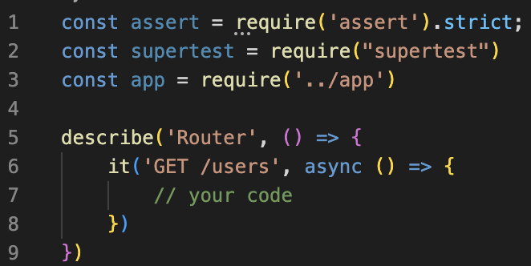
3. API testing
Let’s install supertest ! As always, and you should know the drill now
The setup is almost the same in your test files

Slide 50
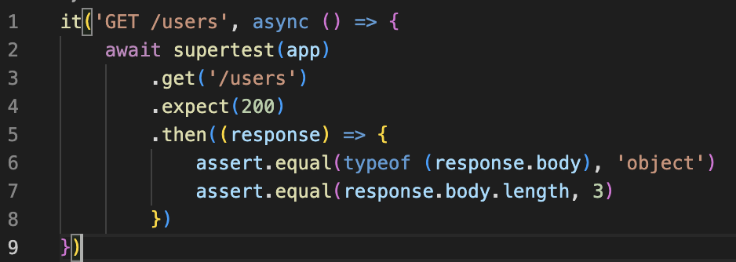
3. API testing
And if we want to write a full test

Slide 51
3. API testing
Let's explain the few lines above
First we pass the app to supertest then ask for the users endpoint.
Then we expect to have an http status code 200 (so a success)
We get the data from the response inside a promise
We validate the content of the response

Slide 52
3. API testing
Same as before try to think of some tests you want to handle with your API
a 200/success case: everything work as expected
a 404 case: the endpoint does not exist
a 400 case: you are missing some parameters or bad validation
a 500 case: your call is crashing the server

Slide 53
3. API testing
Working with complexes responses can be quite tedious if you rely only on the pure assert solution provided by Node.js. You can also use
chai.js
sinon.js
or others libs

Slide 54
3. API testing
Now try to handles all use cases on your projects to have a full testing
solution.
Look at nyc to export a report of your test coverage, it can give you insight on functions or part of your code that are not tested and provide you with a complete output including
% of lines tested
% of functions tested
% of branches tested

Slide 55
Exercises

